Slide 1

Deep Learning
Deep Learning for Engineering Applications
Semantic segmentation of ebhi of the 6 classes

Slide 2
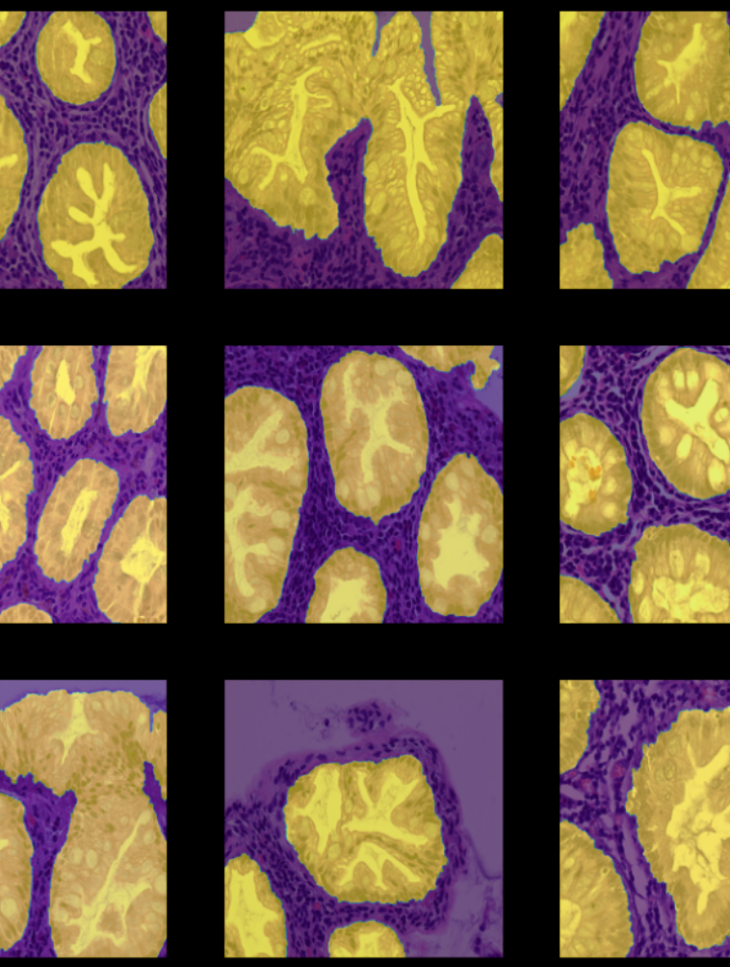
EBHI Dataset – 5170 images
Serrated adenoma
Polyp
Normal
Low-grade IN
High grade IN
Adenocarcinoma

Slide 3

Architecture – U-Net

Slide 4
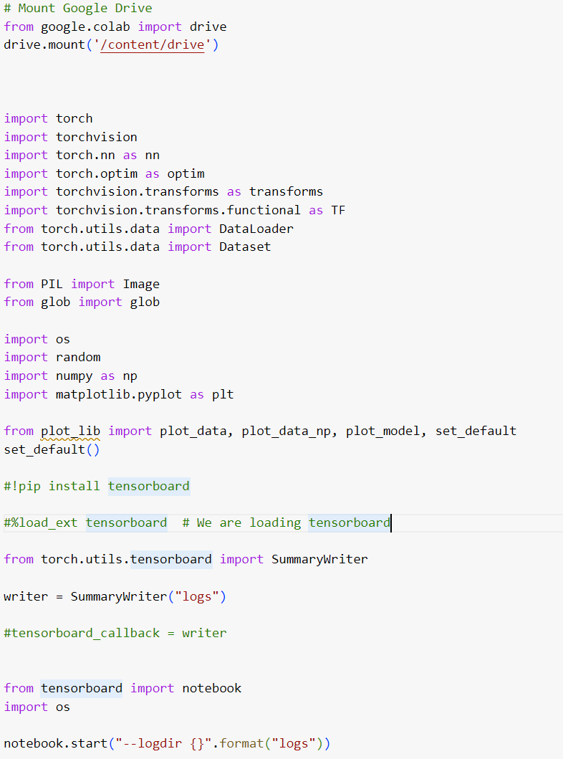
Explanation of the code

Slide 5
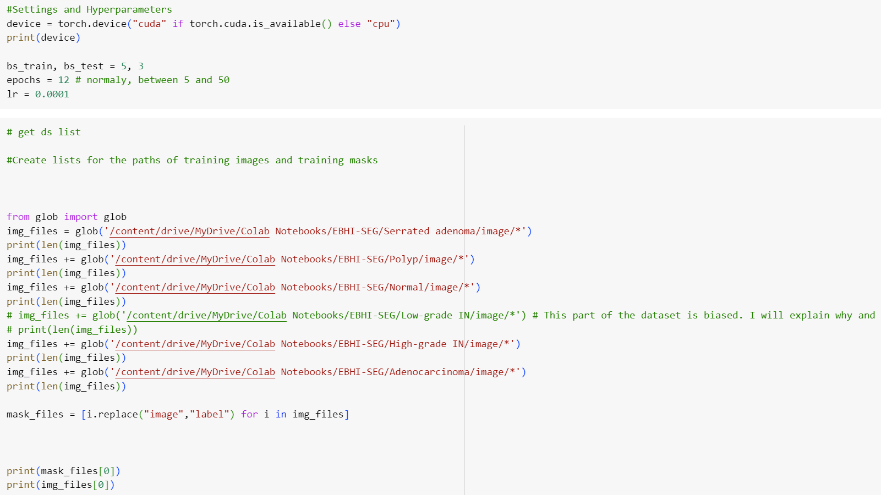

Slide 6
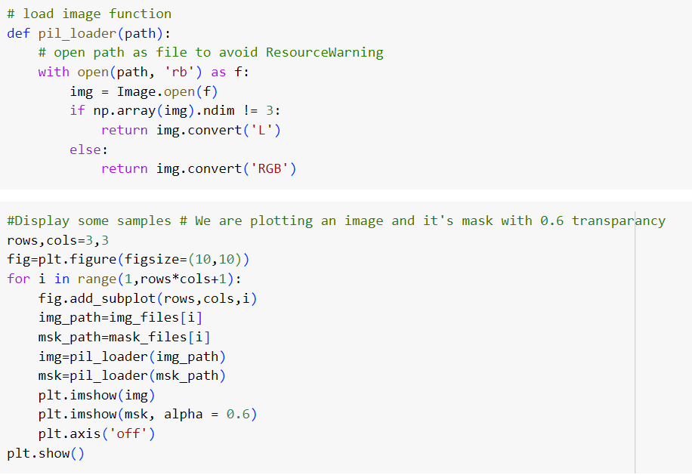

Slide 7
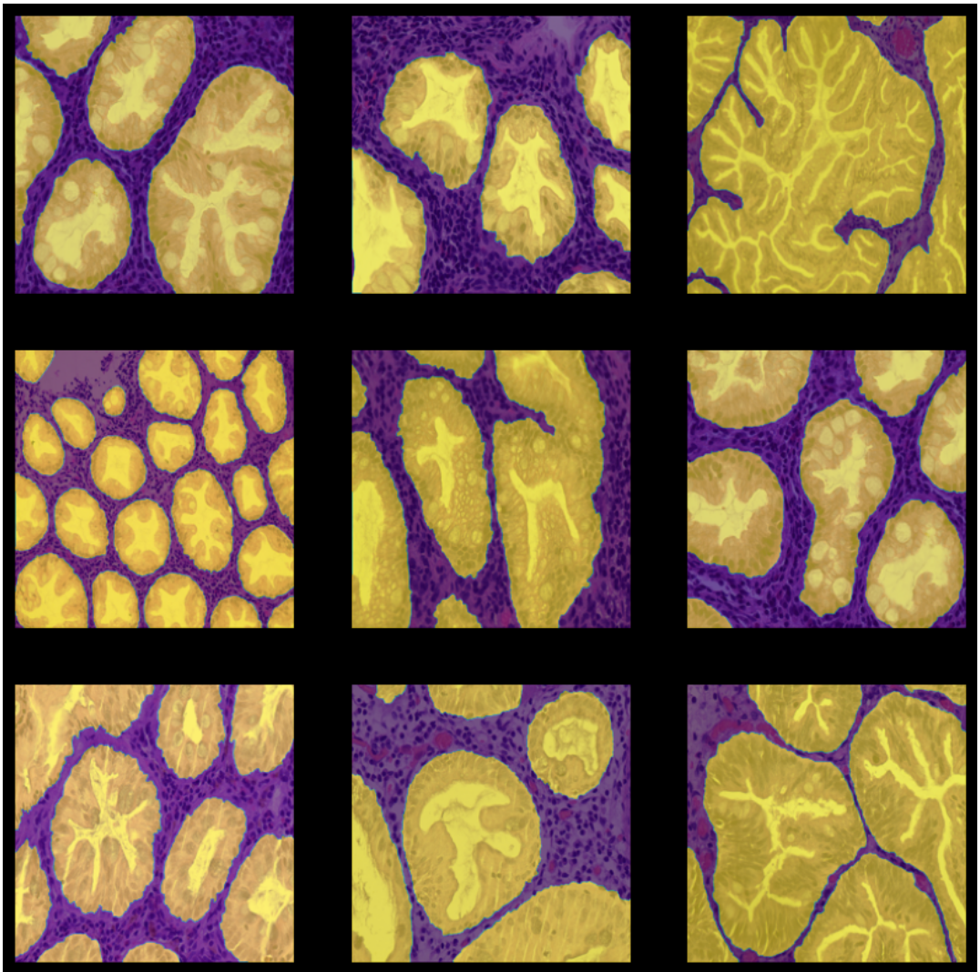
Result

Slide 8
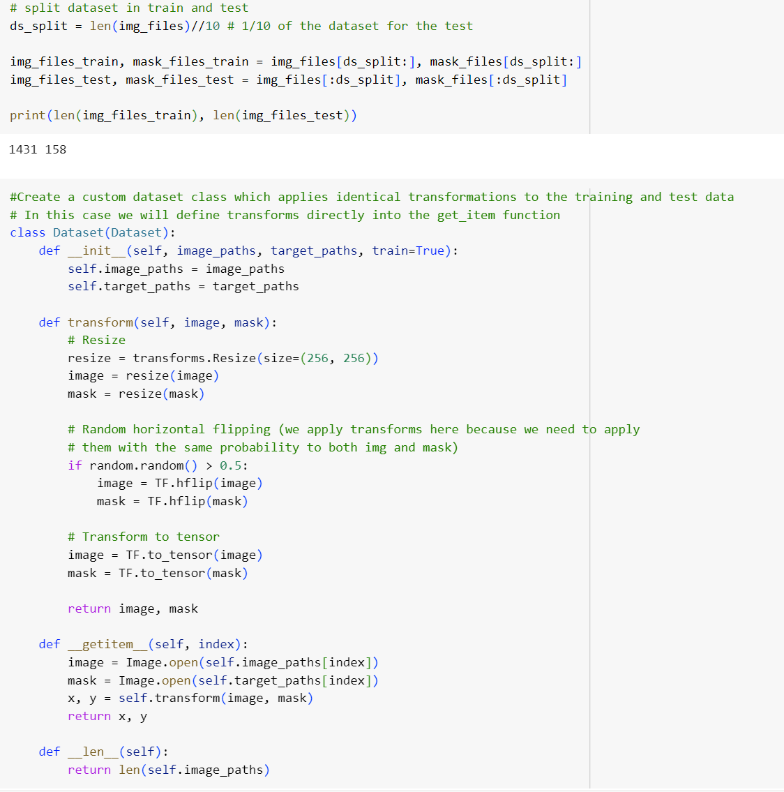
Splitting data and creating custom dataset

Slide 9
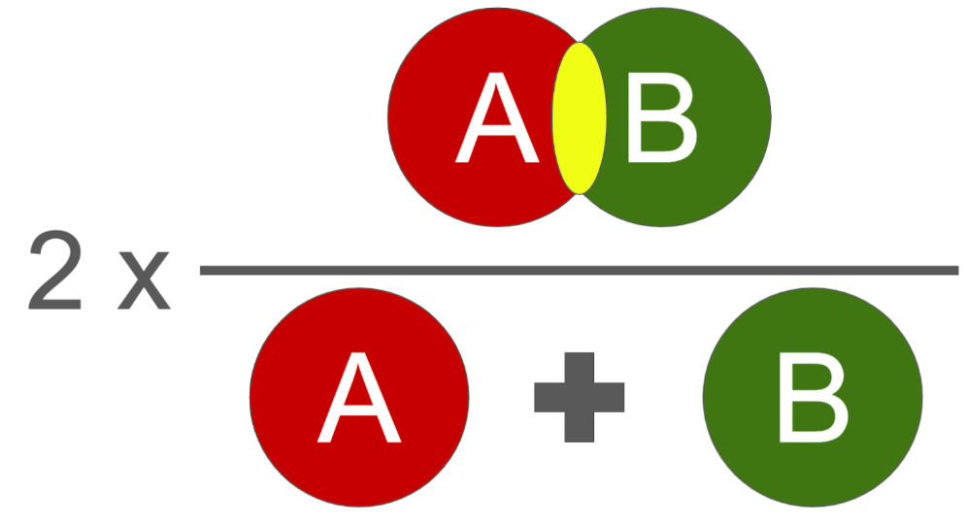
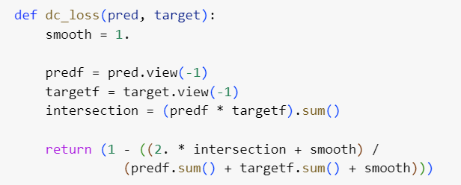
Dice loss function

Slide 10
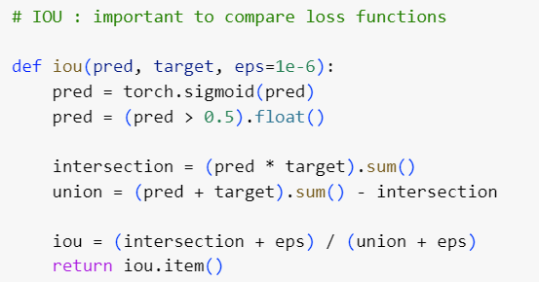
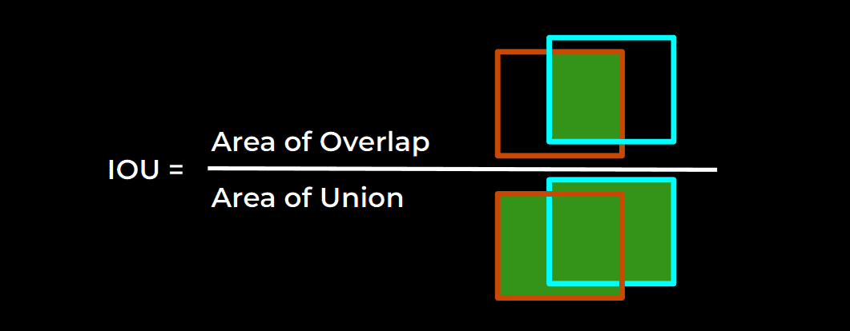
IOU : Intersection over Union

Slide 11
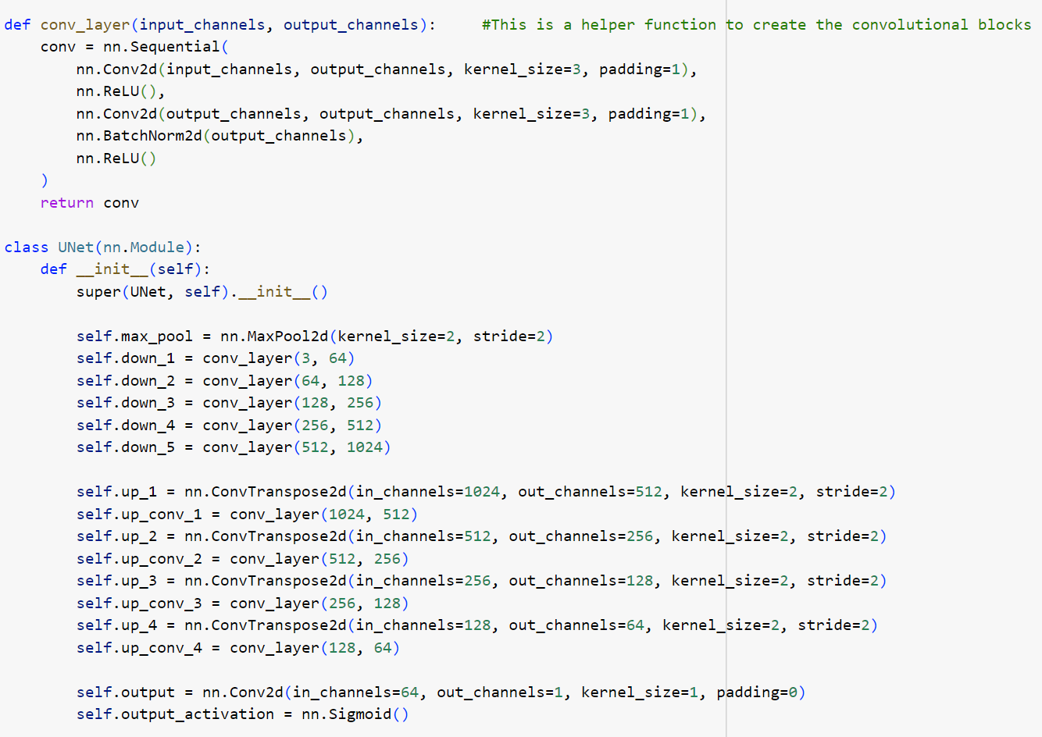
Define the U-Net Architecture

Slide 12
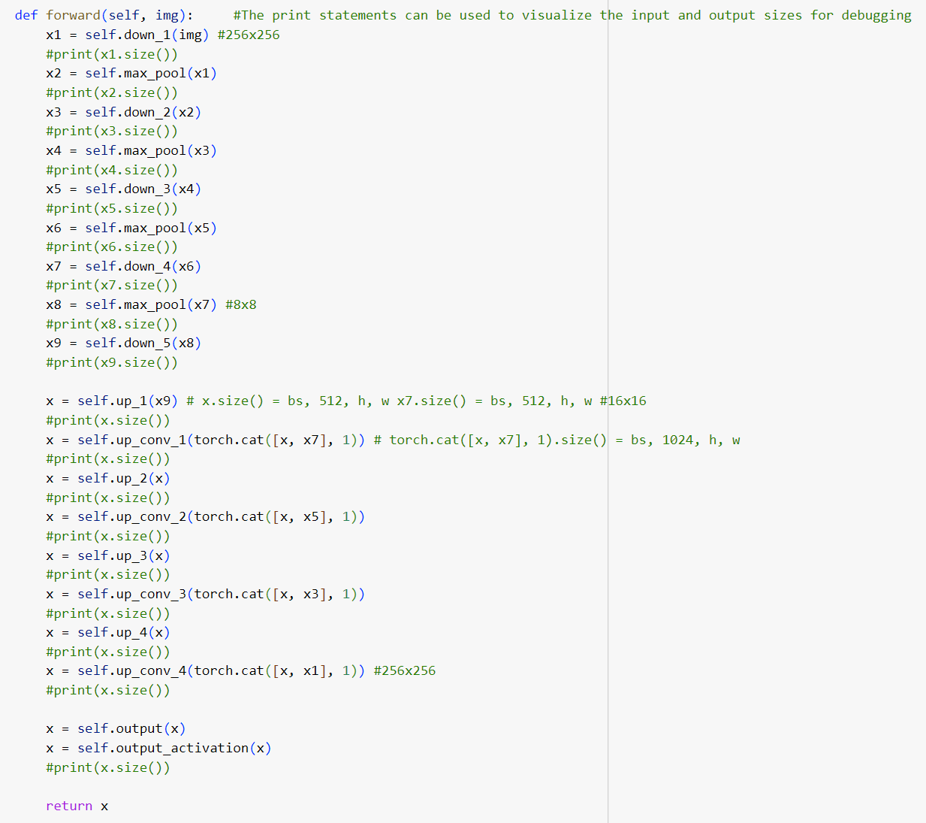

Slide 13
Architecture

Slide 14
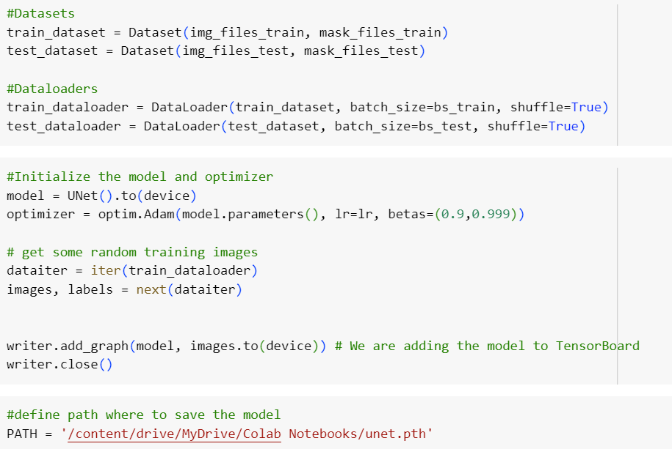

Slide 15
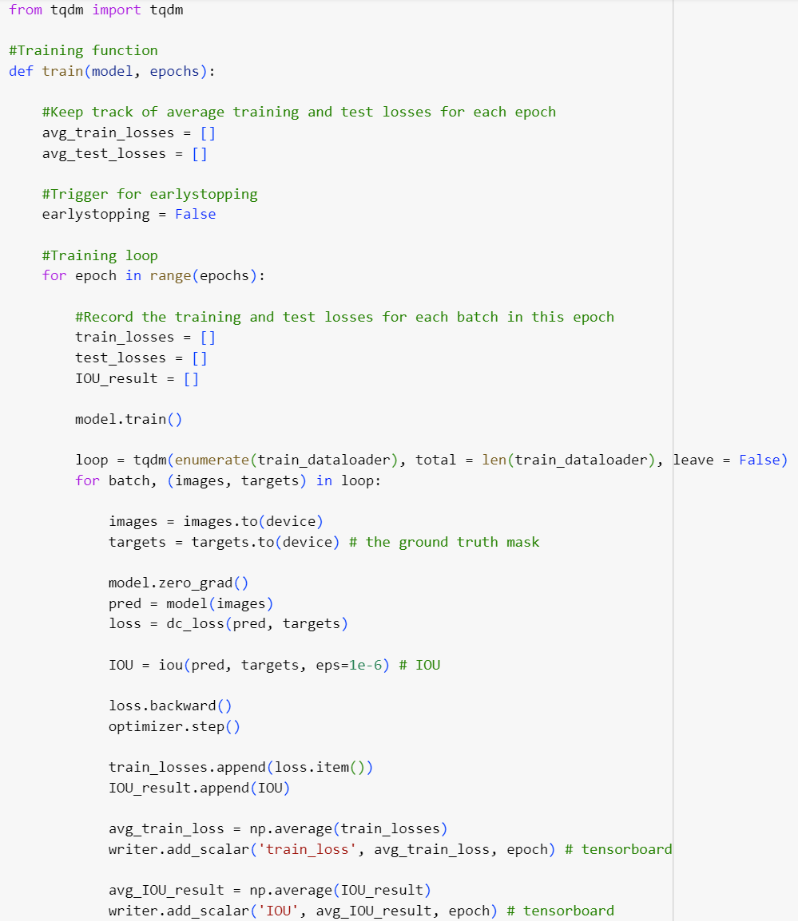
Training

Slide 16
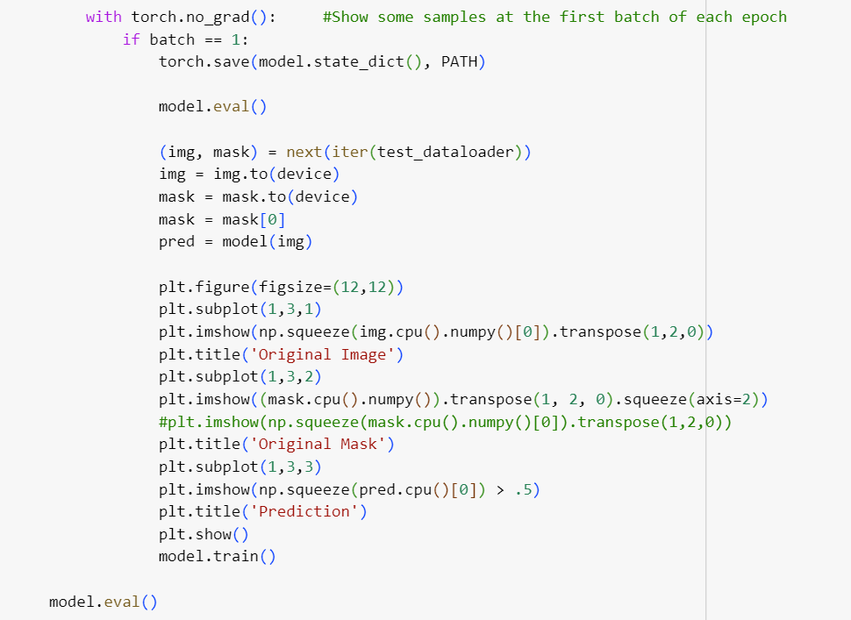

Slide 17
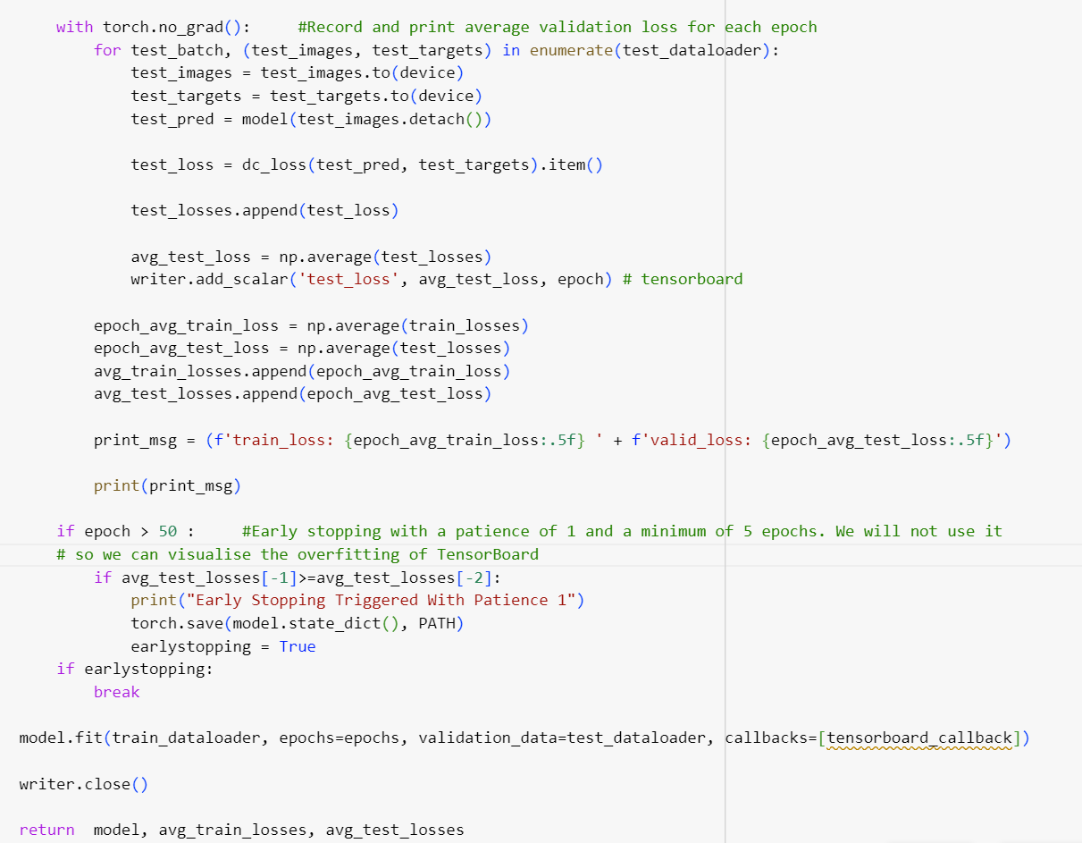

Slide 18
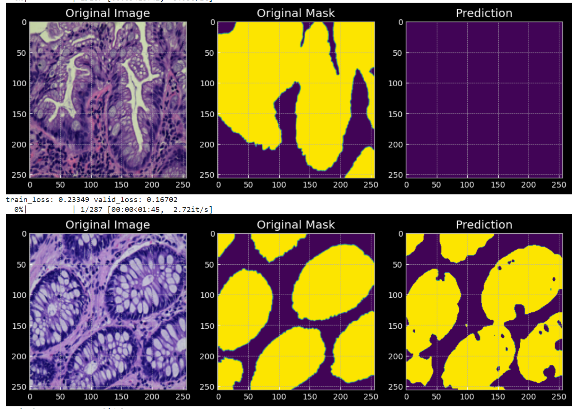
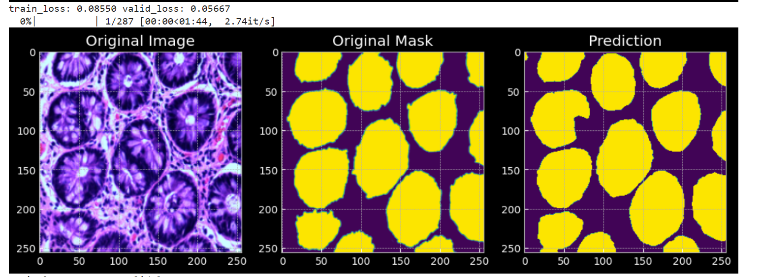
Example of the result

Slide 19

Ablation studies : 8
Number of Epochs
Loss functions :
Dice loss
Binary cross entropy loss
L1 loss
Batch size Train
Batch size Test
Learning Rate

Slide 20
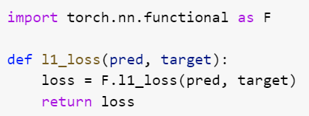
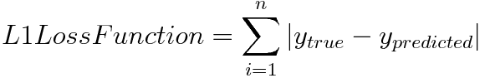
L1 loss function

Slide 21
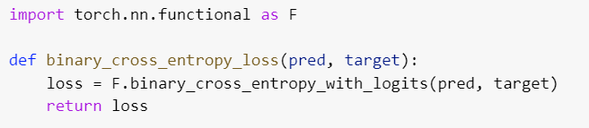
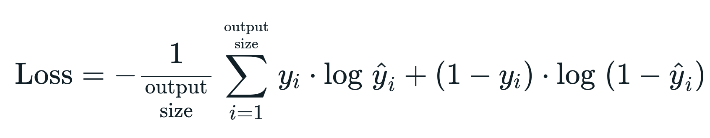
Binary cross entropy loss function

Slide 22

WHY ?
Binary cross entropy is a loss function used in binary classification problems to measure the difference between predicted and true labels.
Dice loss is used to measure the similarity between two sets of data, and it is commonly used in image segmentation tasks.
L1 loss function measures the absolute difference between predicted and true values, and it is used in regression problems.
It is important to train the UNet model with these three loss functions because they capture different aspects of the problem, and their combination can improve the model's performance.
By using multiple loss functions, the model can learn to balance different objectives, such as accurate segmentation, smoothness of the predicted boundaries, and overall pixel-level accuracy.

Slide 23
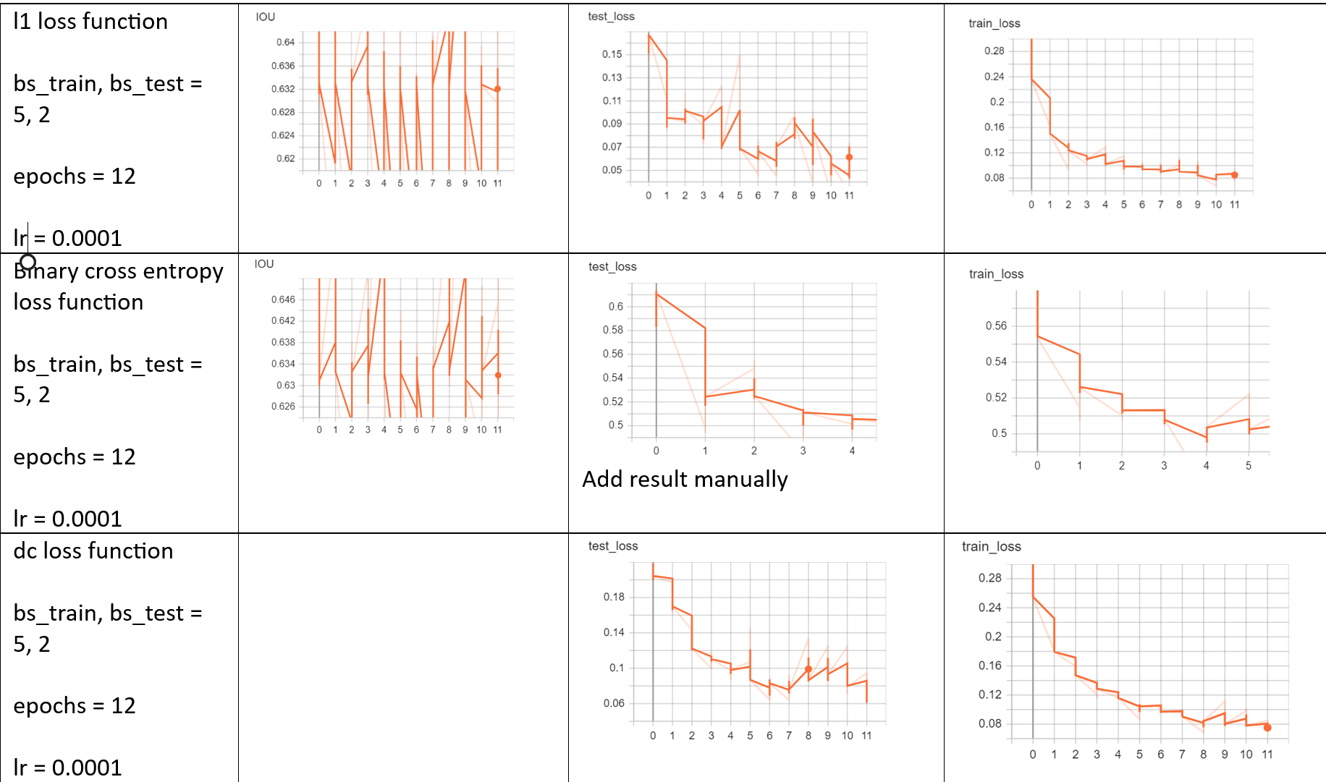
Results

Slide 24
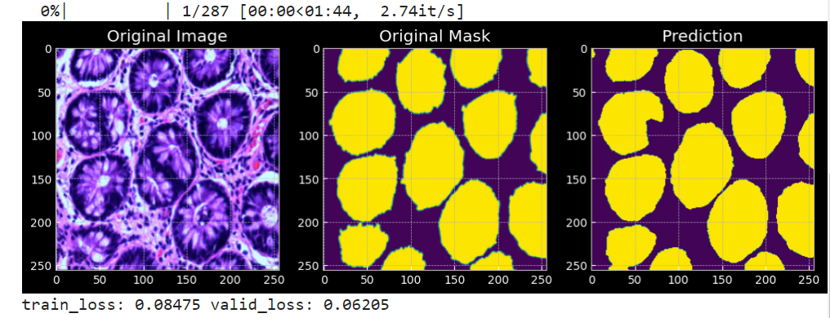
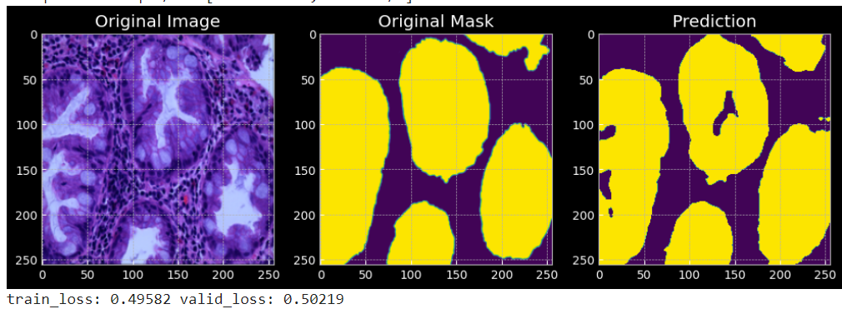
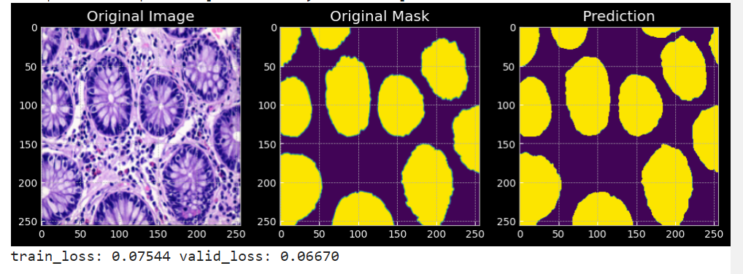
Results
L1 loss :
Binary Cross Entropy :
Dice loss :

Slide 25

Comparing batch test size
Changing the batch size during testing can affect testing speed, memory usage, and prediction accuracy. Smaller batch sizes result in slower testing times and more noisy predictions, while larger batch sizes can speed up testing but may require more memory and produce more stable, accurate predictions. It's best to experiment with different batch sizes to find the optimal balance for a specific model and dataset.

Slide 26
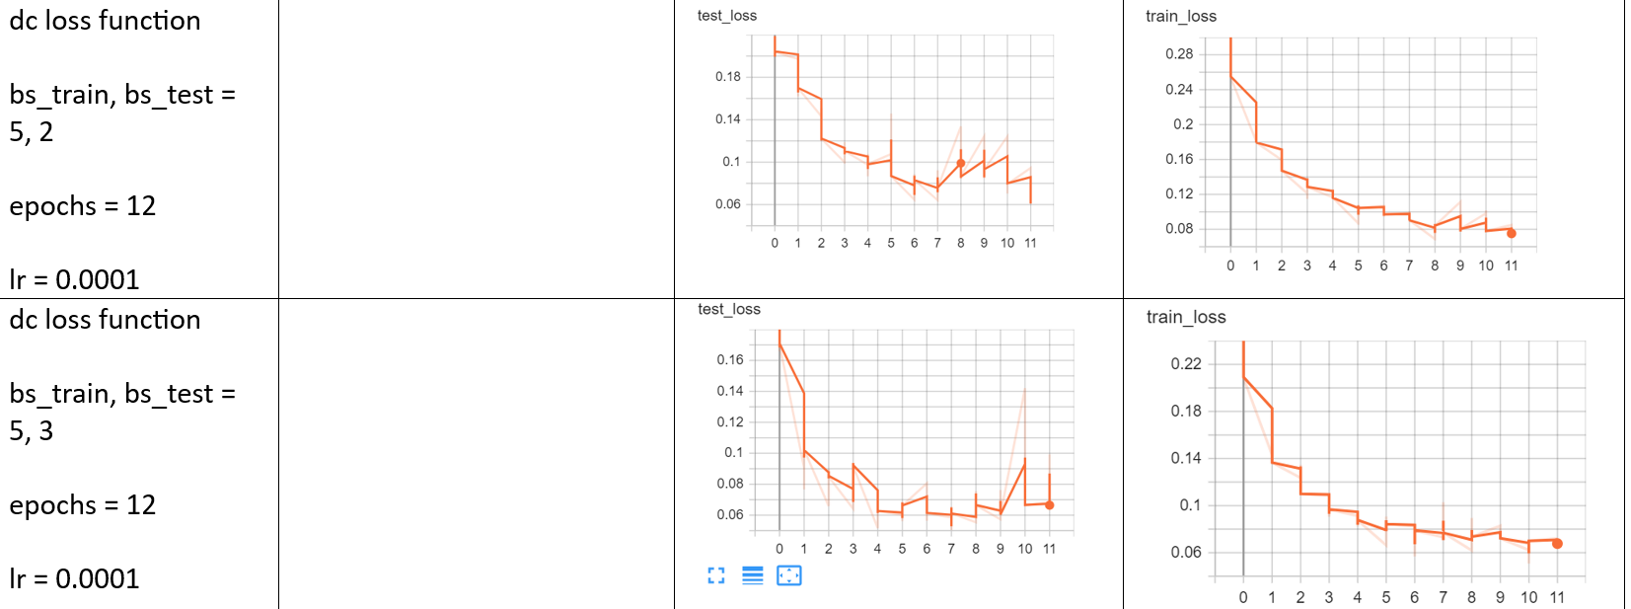
Results

Slide 27
Changing learning rate
Changing the learning rate can significantly impact the training process and the performance of the model. A learning rate that is too high can cause overshooting, while a learning rate that is too low can result in slow convergence or suboptimal solutions. To find an appropriate learning rate, it is necessary to experiment with different values and learning rate schedules. Adaptive learning rate methods, like Adam or RMSprop, can automatically adjust the learning rate during training, reducing the need for manual tuning.

Slide 28
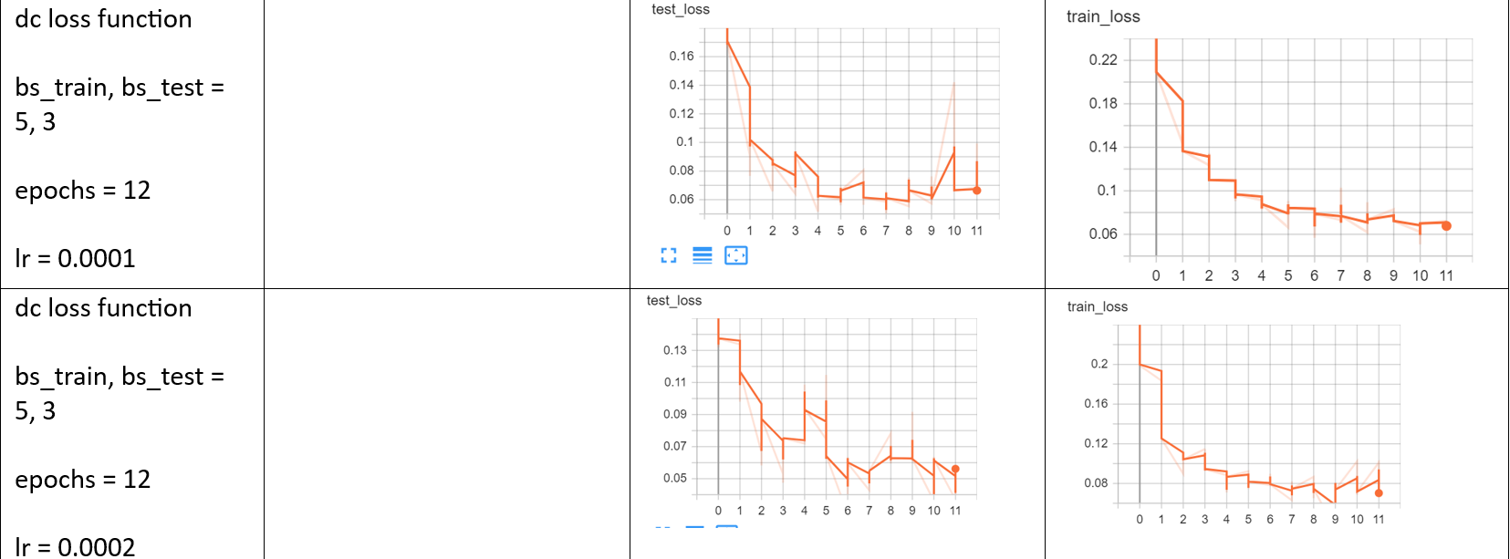
Results

Slide 29
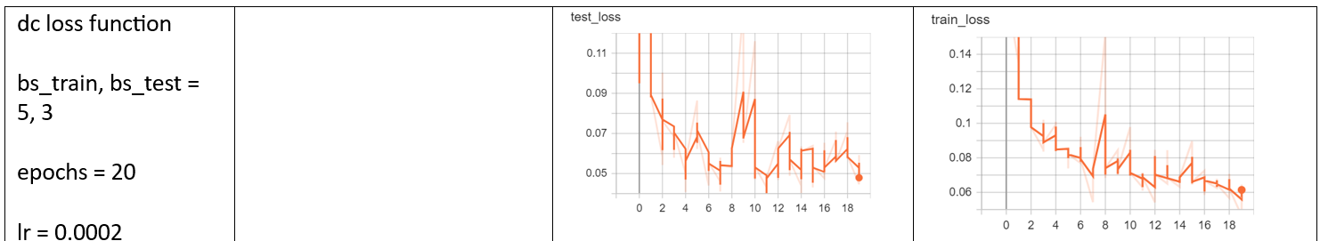
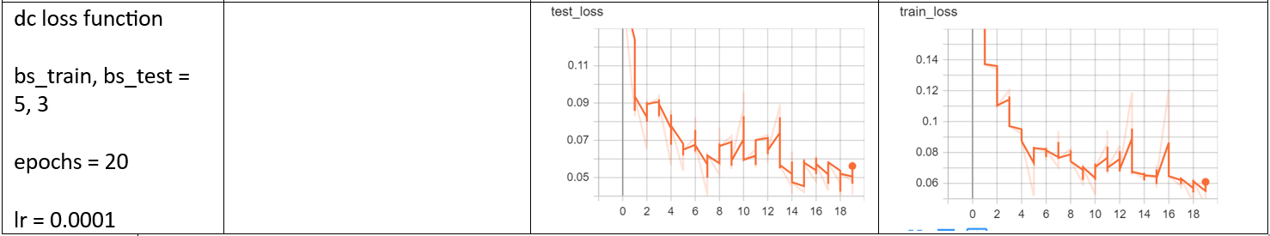
Results

Slide 30

Changing Batch train size
Changing the batch size during training can impact the speed of convergence, memory usage, and overfitting prevention. Larger batch sizes can result in faster convergence but may require more memory and may lead to overfitting. Smaller batch sizes can prevent overfitting, but may result in slower convergence and longer training times. It's best to experiment with different batch sizes to find the optimal balance for a specific model and dataset. Techniques such as gradient accumulation or mixed-precision training can be used to simulate larger batch sizes while using less memory.

Slide 31
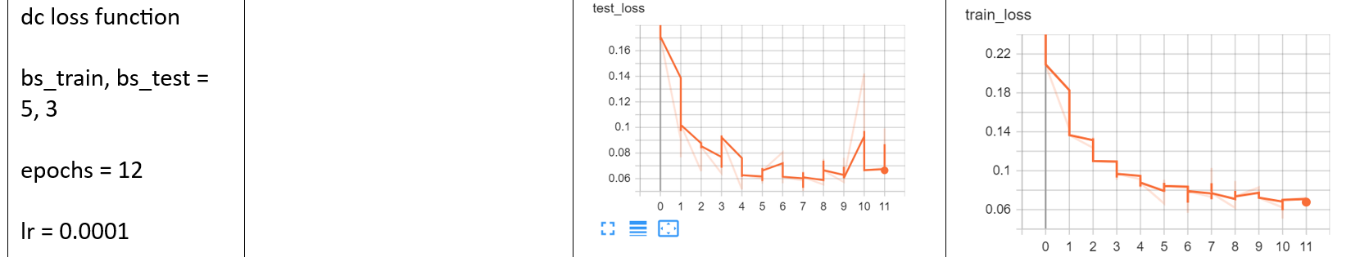
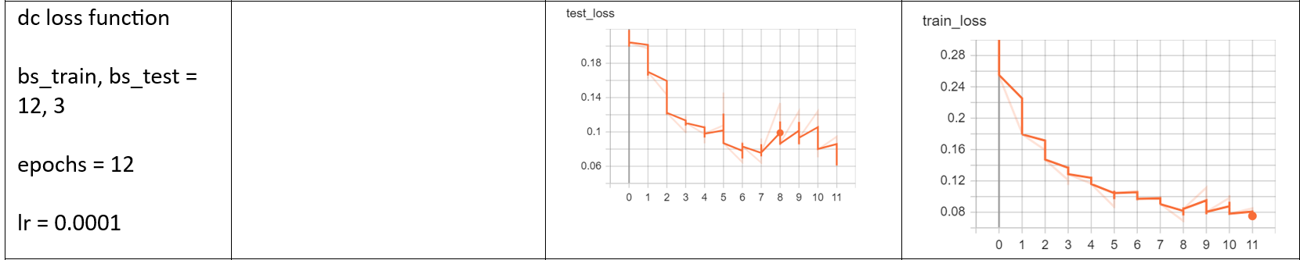
Results

Slide 32
Changing the number of epochs
Changing the number of epochs can impact the model's performance. Too few epochs can result in underfitting, while too many epochs can lead to overfitting. An appropriate number of epochs should be chosen by monitoring the loss function and performance metrics on a validation set. Techniques such as early stopping can be used to prevent overfitting and improve model generalization.

Slide 33
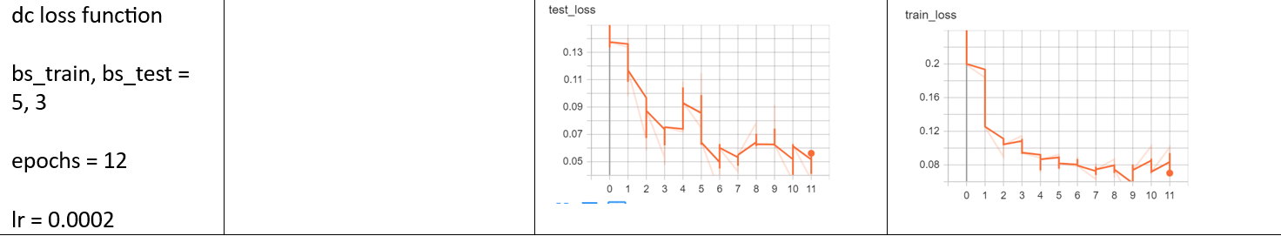
Results

